Slide 1
Capstone Project -
The Battle of Neighborhoods
Opening Coffee Shop in New York City

Slide 2


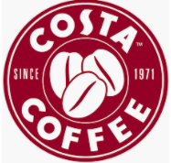
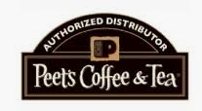
Background
New York City is one of the busiest cities in the world and one of the world’s major commercial, financial and cultural centers. An entrepreneur is looking to open a coffee shop in one of New York’s neighborhoods.
Goals:
Understand the area and the availability of coffee shops in each neighborhood.
Investigate the area and identify the best place to open a new coffee shop
?

Slide 3
Data Requirements and Sources
Dataset1: Boroughs and the different neighbourhoods under each borough of NYC along with its latitude and longitude coordinates.
https://geo.nyu.edu/catalog/nyu_2451_34572
https://cocl.us/new_york_dataset
Dataset 2: Demographics of NYC and segmentation of ethnic races across different boroughs.
https://en.wikipedia.org/wiki/Demographics_of_New_York_City
Dataset 3:
The Foursquare API

Slide 4
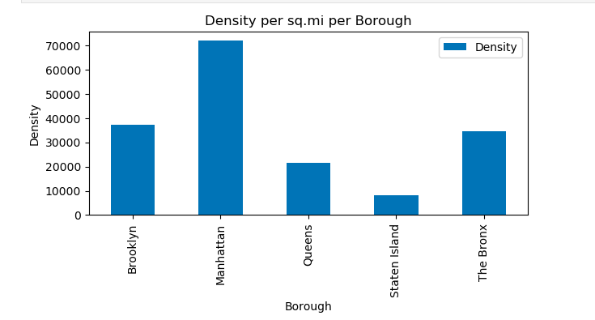
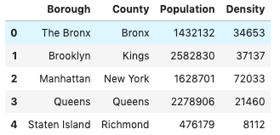
Methodology and Data Analysis
Density of People per Borough
Highest Density

Slide 5
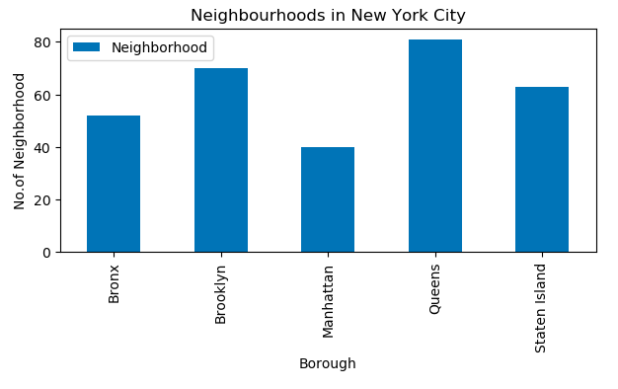
Methodology and Data Analysis - Cont’d
Neighbourhoods in New York City
Least no. of neighbourhood

Slide 6
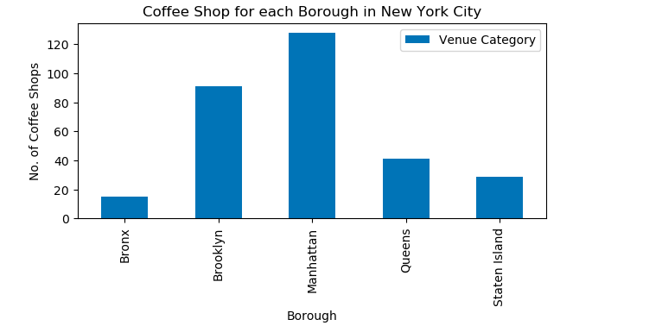
Methodology and Data Analysis - Cont’d
Coffee Shops in New York City

Slide 7
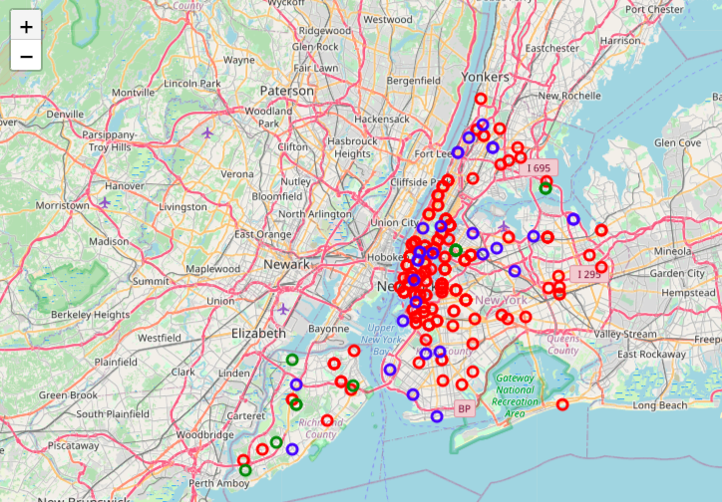
Methodology and Data Analysis - Cont’d
Clusters:
k-means clustering method is used to cluster the coffee shops in New York into 3 clusters.
The results are visualized in the map with 3 clusters in red, blue and green.

Slide 8
Conclusion and Future Decision
The best potential area is : Manhattan
After evaluating the neighborhoods in the New York city based on the density and people per coffee shop as well as the coffee shop spread in New York city. It is noted that the area in the red cluster, which is neighborhood Chelsea, Civic Center, Carnegie Hill etc., is the most popular area for coffee shops.
Future decisions should be made based on other factors such as cost of location, logistics, rental fees and so on for the exact neighborhood to choose in Manhattan within the red cluster area.

